Slide 1

Seismic wavefield simulations of earthquakes in North Island of New Zealand Dr. François Bissey on behalf of Dr. Yoshihiro Kaneko

Slide 2
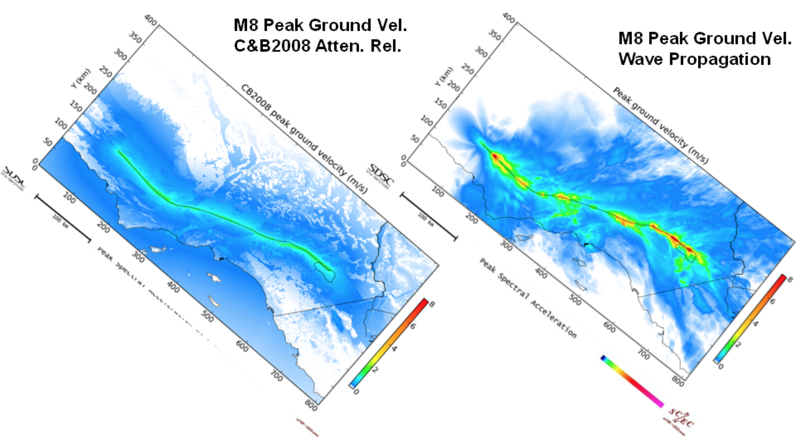
Motivation
Deterministic simulations of seismic wave propagation is a promising approach for probabilistic seismic hazard analysis (PSHA)
Scenario earthquake modeling provides insights into source parameters controlling strong ground motion (e.g., in preparation for a potential M9 Hikurangi earthquake)
An accurate and high-resolution velocity model is essential

Slide 3
Objectives
Validate the 3D velocity model of North Island; perform full wavefield simulations of earthquakes (4.0<M<5.5) using SPECFEM3D
Quantify travel-time discrepency between data and synthetics

Slide 4
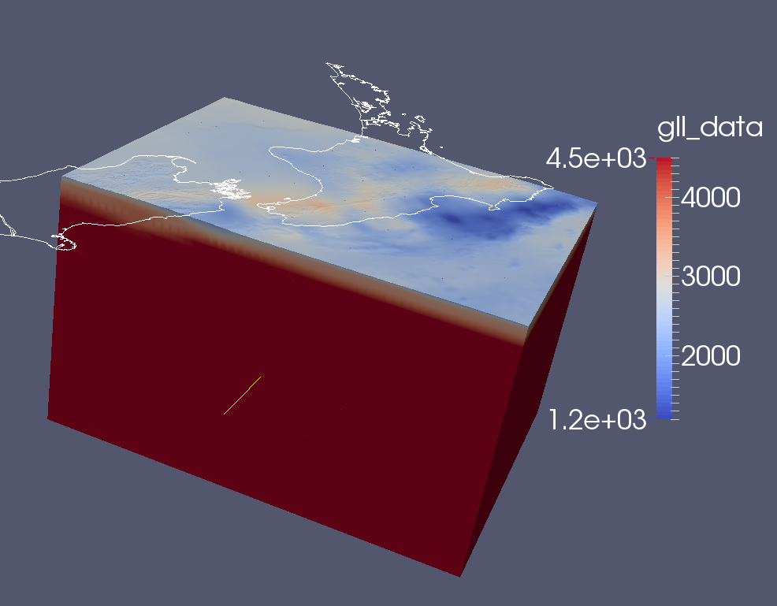
Method
3D velocity model (Eberhart-Phillips et al., 2010; 2012); no attenuation so far.
Topography and bathymetry
Element size of 1.4 km on the surface, 350 m average node spacing; coarser mesh at greater depths
Total of ~70 million node points; one simulation takes ~1 hour using 144 cores on Fitzroy
Simulated waves are accurate down to 2.5 s
Vs (m/s)

Slide 6
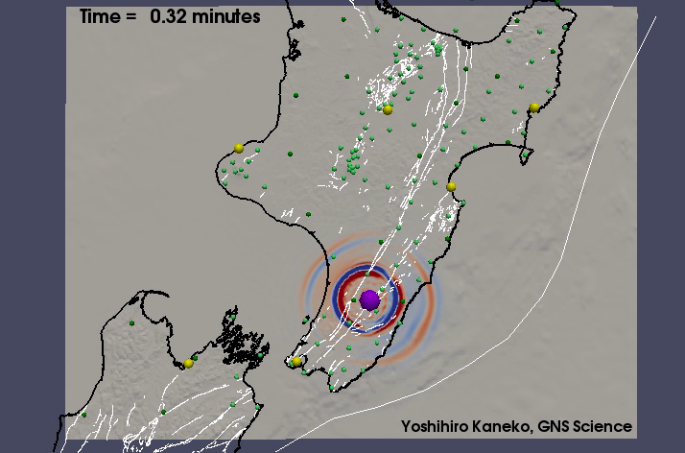
Full wavefield simulation movie: 2014 M6.2 Eketahuna (depth 25km)
Red and Blue represent vertical velocity, respectively up and down.
Yellow dots are major cities.
Green dots are seismometers.

Slide 7
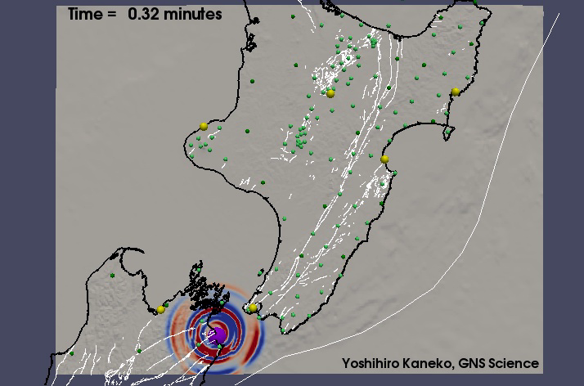
Full wavefield simulation movie: 2013 M6.5 Cook Strait EQ (depth 12km)
Red and Blue represent vertical velocity, respectively up and down.
Yellow dots are major cities.
Green dots are seismometers.

Slide 8
GNS stations
Short period
Broadband
7 EQ of magnitude ~5 are shown.
For this study only the data from broadband station is used.

Slide 9
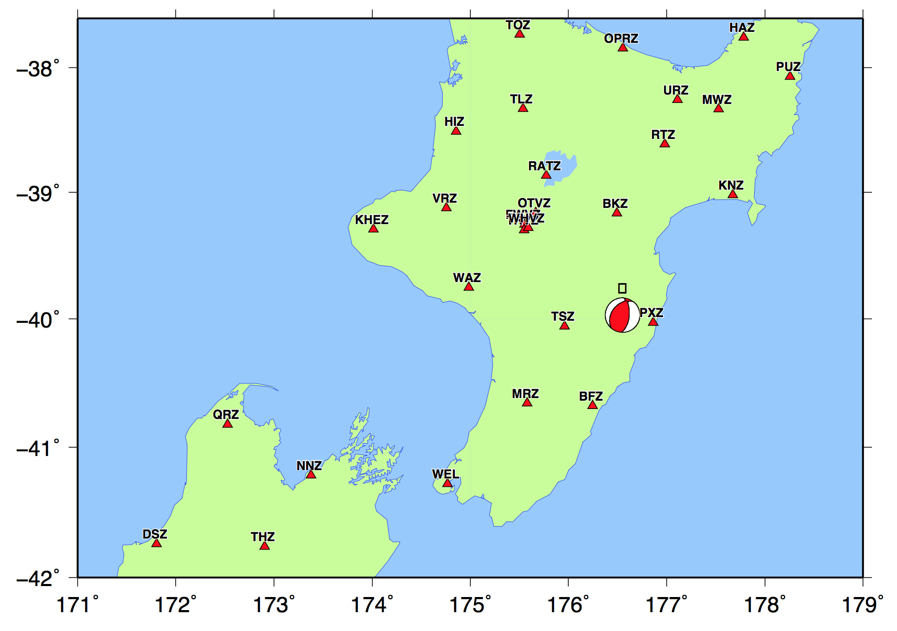
Comparisons between data and simulation Magnitude 5.1 event
In black: recorded data.
In red: simulation

Slide 10
Comparisons between data and simulation Magnitude 5.1 event (2)
In black: recorded data.
In red: simulation

Slide 11
Comparisons between data and simulation Magnitude 5.1 event (3)
In black: recorded data.
In red: simulation

Slide 12
Comparisons between data and simulation Magnitude 5.1 event (4)
In black: recorded data.
In red: simulation

Slide 13
Higher frequencies are more difficult to model….

Slide 14
Conclusions
We have simulated seismic wave propagation within the latest 3D velocity model of North Island and assessed the accuracy of the model
Compared to the 1D model, the 3D model fits observed waveforms better
Yet, the 3D model appears to be systematically faster than the real structure

Slide 15
Future work
Include a latest 3D attenuation (Q) model and compare waveform amplitudes
Improve the 3D velocity model by performing full-waveform inversion (Tape et al., 2009; 2010)

